Slide 1
Implementation of IOT API Using OPC UA
Software Engineering Project Submitted to: Prof. Andreas Pech & Damir Dobric Submitted by: Syed Aqib

Slide 2
OPC UA
Stands for Open Platform Communication Unified Architecture
Industrial M2M Communication Protocol
OPC UA you can integrate all your devices, automation systems and software applications using one secure and platform independent standard
Equally suitable for closed network or used via Internet
Can be used on any software platform such as Windows, Linux, Android, MAC

Slide 3
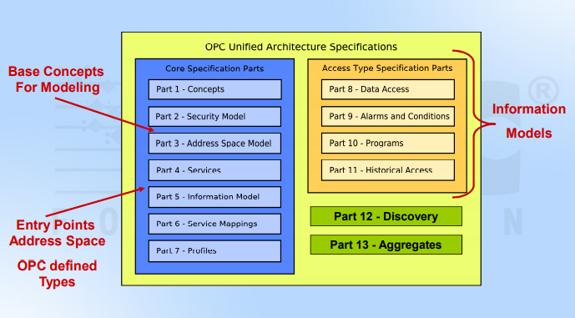
OPC UA Modeling Specification

Slide 4
OPC UA Modeling Specification
Concepts
Message Model to interact b/w applications
Communication Model to transfer data over network
Security Model to generate Cyber Security
Security Model Client/Server Authorization

Slide 5
OPC UA Modeling specification
Security
Provide Counter Measure to resist cyber attacks
Architecture is structured in a application layer and communication layer
Server announces which mechanism it is using and client choses one of the selected policies

Slide 6
OPC UA Modeling specification
AddressSpace
Information should be interoperable, savable in binary form and transferable
A set of objects Server makes available to the client is referred to as the AddressSpace
It allows real time processing

Slide 7
OPC UA Modeling specification
Services
Collection of abstract remote procedure calls that Server implements and Client calls
No particular Implementation is described in this part

Slide 8
OPC UA Modeling specification
Information Model
Make Data available to AddressSpace
Make Data mutually understandable to the diverse systems
Information representation in Computer Centric Data
Vendor Specific Representation can also be defined

Slide 9
OPC UA Modeling specification
Information Model
Make Data available to AddressSpace
Make Data mutually understandable to the diverse systems
Information representation in Computer Centric Data
Vendor Specific Representation can also be defined

Slide 10
OPC UA Modeling specification
Mappings
Different mappings are combined together to create Stack profile
It defines mapping b/w the abstract definitions contained in the specification

Slide 11
OPC UA Modeling specification
Profiles
OPC Profiles are group of services that can be used for conformance level certificate
All applications shall implement at least one Stack profile and can communication with other application using same Stack

Slide 12
OPC UA Modeling specification
Data Access
Additional Information of variable types and a complementary description of AddresssSpace Objects
NodeClasses, attributes are needed for DA specific usage to process data
Alarms and Conditions
Representation of events and alarm in OPC UA AddressSpace
It examines other parts and describes alarm specific uses of the services

Slide 13
OPC UA Modeling specification
Program
Extends the notion of methods and introduces functionality in a server
Which can be invoked by a Client
Historical Access
Additional and Complementary definitions of the representation of historical time series, data and historical even data

Slide 14
Address Space and Address Space Model
Address Space
Server to expose information to the clients
Information Describes the State and the behavior of the process and Server must able to transfer it the both ways
Data must be
Transferable
Addressable (there must be services to selectively access the data)
Meaningful (there must be rules how to apply bit patterns)
In OPC UA the atomic addressable item is called as a node

Slide 15
AddressSpace and Address Space Model
Each node is a collection of Attribute values
To enable browsing i.e. to represent information about the nodes are interconnected by References
Address Space Model
Exposing nodes to clients to make meaningful context to underlying processes
To create Address Space nodes are initiated and are interconnected using References
Nodes are well defined as a result of definition of NodeClasses

Slide 16
AddressSpace and AddressSpace Model
Address Space Model defines the following NodeClasses
View: defines a subset of nodes in the Address Space.
Object: is used to represent systems, system components, real-world objects and software objects.
Variable: is used as real-time process data holders, i.e. it provides a value.
Method: is a lightweight function, whose scope is bounded by an owning object.
ObjectType: provides definition for objects.
DataType: is used to define simple and complex data types of the Variable values.
ReferenceType: is used to define the meaning of the nodes relationship.
VariableType: is used to provide type definition for variables.

Slide 17
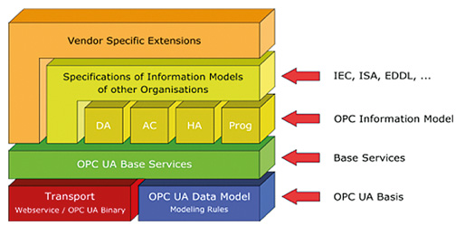
Information Model

Slide 18
Information Model
OPC UA uses an object as a fundamental notion to represent data and behavior of an underlying system
The OPC UA Information Model provides features such as data abstraction, encapsulation, polymorphism, and inheritance.
For the purpose of unification of the information representation the producers (servers) and consumers (clients) use the type notion.
The main role of the types represented by the above NodeClasses is to provide a description of the Address Space structure and to allow clients to use this knowledge to navigate to desired information in the Address Space exposed by the server.

Slide 19
Information Model
Object Type NodeClass
Allow definition of custom types
Can be nested
ObjectTypes folder organizes object types
Typical items in Address space Folders are used to organize the address space
Root folder provides the main entry point into the address space

Slide 20
Information Model
Variable Type NodeClass
VariableTypes folder organizes variable types
VariableTypes can contain variables and properties
A property is just a variable that can not contain additional variables (leaf)
Are components of objects representing the data of objects
Can be complex and can have Properties
Can be typed (VariableType)
Properties are providing metadata for nodes

Slide 21
Information Model
Variable Type NodeClass
VariableTypes folder organizes variable types
VariableTypes can contain variables and properties
A property is just a variable that can not contain additional variables (leaf)
Are components of objects representing the data of objects
Can be complex and can have Properties
Can be typed (VariableType)
Properties are providing metadata for nodes

Slide 22
Information Model
Variable Type vs Data Type
Defines a structure describing the Properties or Variables an instance of a Variable would provide
DataType
Defines the Data Type of the Value Attribute of a Variable
Can be scalar (e.g. Float) or complex type (e.g. Structure) ■
Data Type ID of a Variable is the NodeId of the DataType Nodes

Slide 23
DEMO

Slide 24


